Slide 1
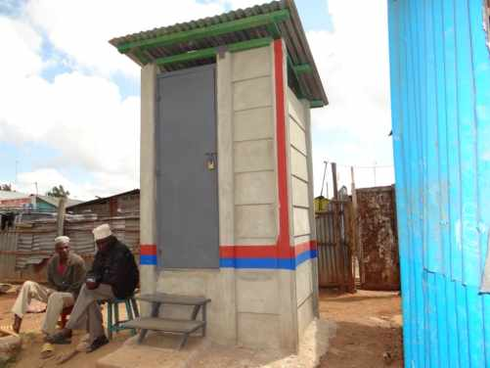
WATER SECTOR TRUST FUND
Up-scaling Basic Sanitation for the Urban Poor (UBSUP)
What is a SafiSan Project?
Version:2.0
Last Update: August 2017

Slide 2
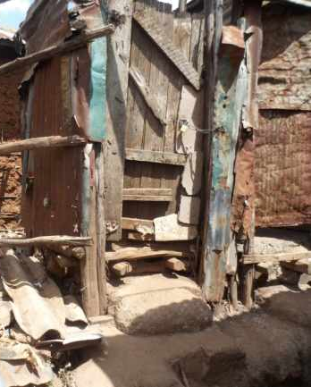
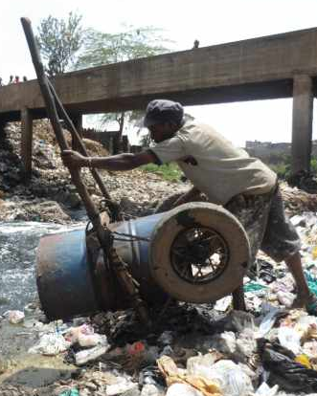
The name SafiSan
Derived from Safi (Swahili word meaning clean) and sanitation (English word meaning hygienic management of human faeces)

Slide 3
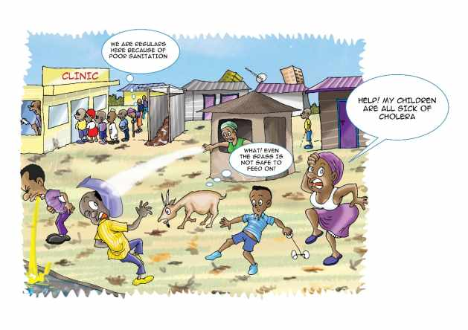
When it comes to sanitation, what are some of the challenges that we face???

Slide 4
Sanitation challenges in Kenya
• Biased government priorities on sanitation - A largely focused effort on improved water supply as opposed to improved sanitation; no proactive policies for low income areas
• Most resources/ funding set aside for sanitation have been assigned for hygiene education. Toilet construction has never been a priority
• Split sanitation sub-sectors (in different ministries) yet, without a common command centre; each group without clear understanding of the depth and responsibilities.
Notes:
Explain to them the different ministries, explain the issue of regulation

Slide 5
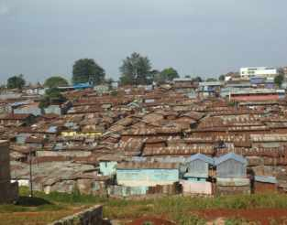
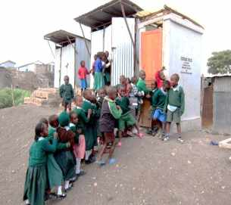
Sanitation challenges in Kenya
Poor sanitation monitoring hence non adherence/ignorance to laid down regulations on toilets construction (particularly in low income areas) and waste disposal
Lack of sewerage infrastructure by the WSP owing to high costs of investments
Large and increasing population densities coupled with an ever increasing rural urban migration (urbanization - 4.2% p.a.)
Landlords have priority in making more houses at the expense of toilets construction
Notes:
The first and the last point need to be explained in detail.

Slide 6
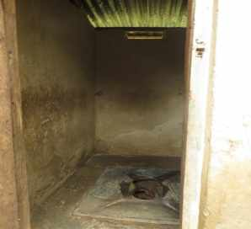
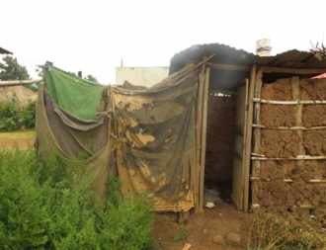
Sanitation challenges in Kenya
Lack of space in densely populated low income urban areas
Lack of low cost designs/technologies for sanitation in the Kenyan market
Lack of unified platforms for sharing best practices/approaches in sanitation that would promote wider up-scaling
Low status and poor morale of manual emptiers due to unsafe/ unhygienic, emptying, transportation and disposal practices
Notes:
The first and the last point need to be explained in detail.

Slide 7
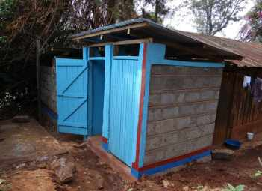
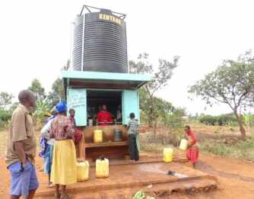
What is the Water Sector Trust Fund?
WSTF is the pro-poor basket fund of the water sector which is successfully up-scaling water supply and public sanitation in urban low income areas through the Urban Projects Concept (UPC) window
To address the sanitation challenges, the WSTF has developed a concept for up-scaling basic sanitation at household and plot level in low income urban areas which will be implemented between 2013 and 2016. This is known as the UBSUP/SafiSan programme

Slide 8
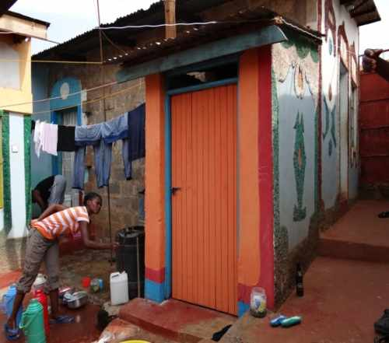
Water Sector Trust Fund
The UBSUP/SafiSan programme is implemented through UPC which has a proven track record in implementing projects with the WSP’s
The project is funded by KfW and the Bill and Melinda Gates Foundation (BMGF) with technical support from the German International Cooperation (GIZ)

Slide 9
What is UBSUP?
Upscaling Basic Sanitation for the Urban Poor
A six-year programme (2011- 2017); project financed through the Water Services Trust Fund (WSTF) and implemented by the Water Service Providers (WSPs)
GOAL:
Improving living conditions by promoting sustainable sanitation to residents of urban low income areas in Kenya

Slide 10
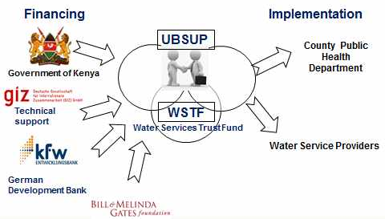
Financing and Implementation

Slide 11
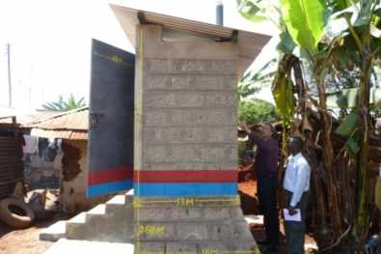
Policy developments
The water sector has put necessary policy, legal and institutional frameworks to improve sanitation as part of the water sector reforms of 2003,
Constitution of Kenya 2010 (article 43(b) has recognized reasonable sanitation as a constitutional right
Ministry of Environment, Water and Natural Resources (MEWNR) has drafted a new national water policy of 2014 which aims hasten the development of access to clean water/sanitation

Slide 12
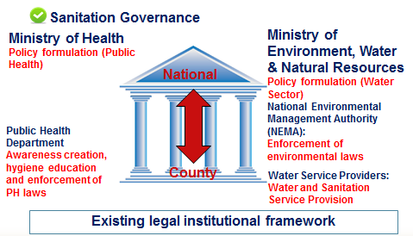
How is Sanitation governed?
Ministry of Water and Irrigation
Notes:
Explain this in detail. Allow a lot of room for questions

Slide 13
The UBSUP approach (1)
Call for proposal: WSTF floats an UBSUP call for funding to the WSP’s
Water service providers apply for the UBSUP project within their jurisdiction with a minimum demand of 200 toilets (Phase 1)
Upon being awarded the funding, the WSP then conducts a public meeting of artisans within the project area and beyond. Artisans are then introduced to the opportunity; toilet designs and the terms of the project are indicated
The WSP then registers these artisans in a database

Slide 14
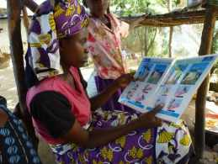
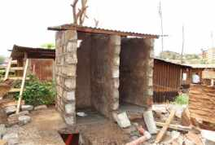
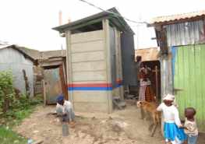
The UBSUP approach (2)
The WSP then recruits and trains Social marketers (Social Animators) who then trigger the uptake of toilet demand on both household and plot levels
Households/Landlords who accepts the sanitation message are registered on a sanitation database by the S.A.
Households/Landlords then choose their toilet preference from the UBSUP standardized toilet designs (UDDT, Pour flush, cistern flush) then and contracts an artisans to build toilet according to UBSUP standard designs

Slide 15
The UBSUP approach (1)
Supervision of construction is done both by a technical representative of the WSP and a field monitor from the Water Services Trust Fund
After a satisfactory report from the inspection of both WSP and WSTF team, a subsidy 20,000 Kenya Shillings per toilet is paid to the Toilet owner, this is irrespective of the toilet chosen; whereas , a subsidy of 15,000 Kshs is paid if the toilet had been rehabilitated

Slide 16
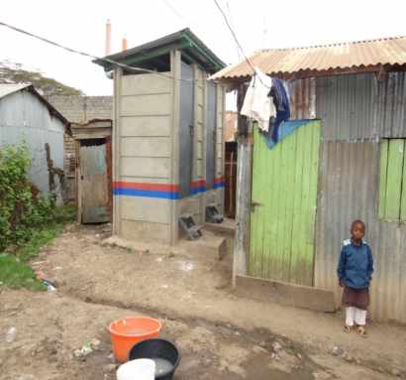
Objectives of the UBSUP/SafiSan Programme
Aims to achieve up-scaling of basic sanitation by developing, testing and implementing innovative and practical on-site sanitation systems and service delivery
Aims at improving the living and health conditions of the urban poor through enhanced access to basic sanitation

Slide 17
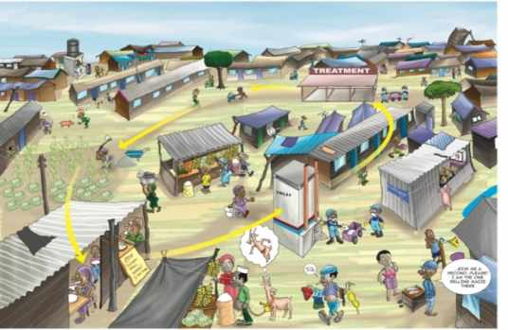
Objectives of the UBSUP/SafiSan Programme (2)
Promotion and inculcation of best hygiene practices through awareness creation and sensitization
Integration of sanitation as a key component in the water and health sector policies so as to ensure sustainability

Slide 18
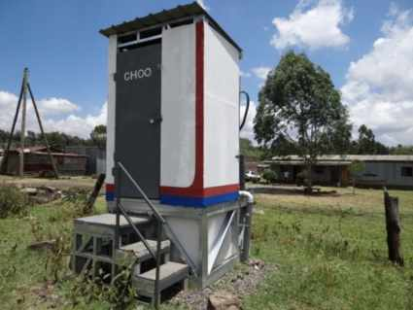
Target and status of SafiSan
Target
To reach 600,000 people with improved sanitation and 200,000 people with improved access to clean water
Status
Concept development stage complete
Testing and pilot phase complete in Oloolaiser, Nakuru and Embu
Up-scaling has began 2015 with the first 20 WSPs being financed for the project!

Slide 19
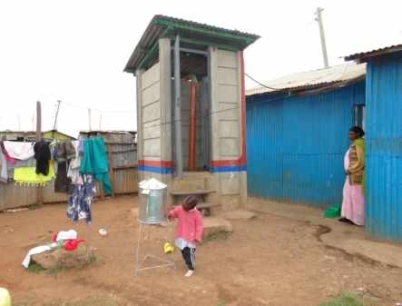
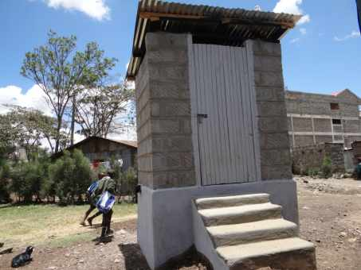
Some UBSUP toilets

Slide 20
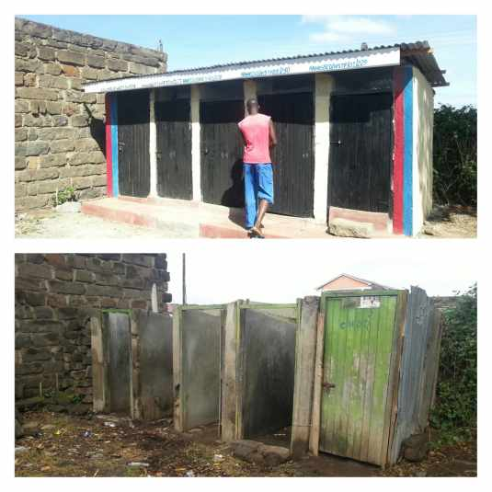
Rehabilitated toilets

Slide 21

Have you understood everything about the UBSUP programme?
Thank you!

